Slide 1
Production Monitoring System (PMS)

Slide 2
Overview – Proposed solution
Key objectives of the RFP released are as follows:
To Propose a system to measure PMS based on Performance, Quality and Availability Data (OEE)
To undertake the required integration with SAP, LED panel and other systems
To Implement the proposed system to capture required data
To implement the required Reports
To provide user based access
To Implement the Notification or alerts as required
To define the process for the required support post implementation

Slide 3
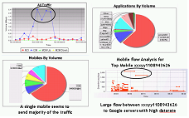
pView – Solution Architecture
Proposed solution is based on pView, state of the art Analytics and Process Automation system (APA)
Real time logs
pView Data Ingestion module (80%)
Rule Engine
Automation
Manager
Structured Data
Data
Data
Data
Data
Unstructured Data
Data Pool
Data
Data
Network Provisioning
Intelligent Alerts
Causal analysis
Targeted Campaigns
Acquisition Campaigns
Retention Campaigns
Churn Management Campaigns
Notification Campaigns
Contextual Campaigns
Executive Dashboards
Business Intelligence and Analysis
pView has been appreciated by our clients like airtel, Vodafone, Lightstorm, EyeQ, Netmagic as one of the most flexible and efficient platform
Single Window for Data across Vertical
Cross vertical correlation analysis
CEO Dashboard
Custom Analysis

Slide 4
Details – Proposed Solution
Module 1 – Data Ingestion
SAP data is already working and ready for integration
Scanner is proposed at the stage where production team takes off the Faulty product for maintenance
Module 2 – Rule Engine/Data Manipulation
To process the Data for required analysis. Processing required analysis report generation with respect to Assembly line, Product Category, Date and Time, Fault Type etc
SAP will be used for Production Data at the given frequency
Data Ingestion module
Data Pool
Adapter
SAP
pView (Rule Engine)
Data connector
Config data
Raw Data
Scanner (Proposed)
Parser
Data Processor
Data Manipulator
Data Handler
Processed Data
Rules
Data Producer
For QA Fault, Scanner data will be used to segregate the QA faults
Data Sources
Module 3 – Visualization / Events / Data Analysis
Based on the Use case, final output of the entire work flow or a logic may be a Dashboard or Event trigger to another work flow or Output data or WhatIf Analysis or Data Analysis Module
Data Export
Notification
Dashboards
WhatIf Module

Slide 5
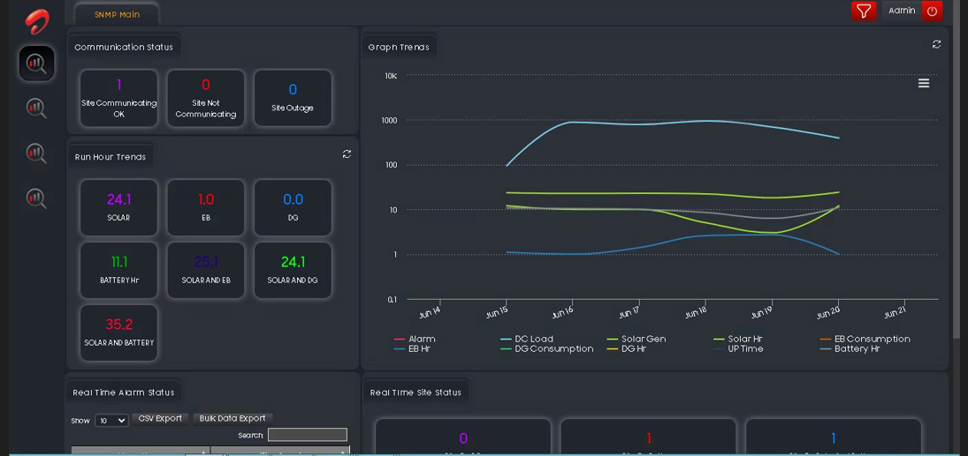
Single Pane of Glass – Proposed Definition
Adherence Report
GAP Analysis Report
Alerts
Summary Faults
Product wise Performance - Assembly Line wise, Product Type
Quality Summary – Assembly line wise and Product wise
Balance Count
Overall OEE Score
Single Pane of Glass may show Trend Charts, Counter Values, Tabular Data, Alerts or other widgets. These may be customized for user specific views. Actual Wireframe will be part of activity after go ahead is given

Slide 6
Work Flow – SAP data collection and processing
Step 1
SAP will PUSH the data over API or Proposed system will PULL the data using SAP API
Step 2
Data will be inserted into the Master database of the proposed system
Step 3
Data processing is executed based on Assembly Line number, Product Type, Date and Time,
Step 6
Notifications are raised over the channel agreed upon for all thresholds
Step 5
Reports are refreshed on the LED Panels
Step 4
Reports are generated to calculate OEE score based on P, Q, A Data

Slide 7
Work Flow – Fault Data Collection (New Flow)
Step 1
QA Personnel will keep marking the Faults as is being done currently
Step 2
Assembly line personnel who takes off the garments will use new App on a mobile phone
Step 3
App will scan the QR code of the garments
Step 6
Data processing is done and all the required analytical reports are generated
Step 5
Data is submitted to the proposed system database
Step 4
After Scanning, it will show the menu pop up on the screen to select the Fault by clicking on the check box

Slide 8

Fault Analysis (FA) App Flow (New Flow)
Scan the garments QR Code
Choose Rejection Cause
Cause submitted
Reason 1
Reason 2
Rejection code for garments with Code ABC1234546 submitted
Reason 3
Reason 4
Reason 5
Reason 6
next garments
scan
submit
exit
Step 1 - Assembly line personnel who takes off the garments from the assembly line after QA Test will Scan the QR code of the garments using FA App (Fault Analysis App)
Step 2 – After the Scanning, FA app will show a list of Faults with check boxes. Assembly line personnel will click on the boxes as per QA Test
Step 3 – Fault Data will be submitted on the server for analysis

Slide 9
System Specifications
Hardware specifications on any virtualized platform are as follows:
Total servers required - 01
Number of Cores - 04
RAM required - 16 GB RAM (Subject to change Depending upon the actual size of data it will be calculated)
Storage/Hard Drive Capacity – 100 GB (For 2 years of data analysis)
Database – MySQL Standard Edition

Slide 10
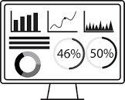
Network architecture
Server Installed at CustomerData Center
Integration with SAP Database
Customer IT network
SAP Server
UI/Web Panel
4. Scan request to the respective Device in the network to ensure that Blocking is done
Production Management System
Application server
5. Scanning of the Blocked URL is done on the respective Device over the respective network – Mobile/Broadband
LED Monitor connector
Internet cloud
Local machne for connection with LED panels
Customer Plant
Number of LED panels can be as required
LED Panel
LED Panel

Slide 11
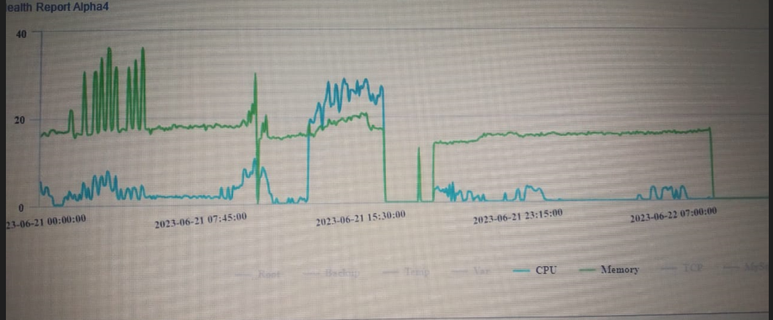
Support and SLA
Problem Severity (w.r.t. impact on business) | Response Time | Work Around (Best Effort) | SLA
Emergency/Critical (In case downtime is leading to total revenue loss) | 1 hour | 4 hours | The correction work starts immediately and continues until a work around solution is available. After a work-around solution is available, the case is downgraded to Major category.
Major/High (In case down time leads to partial revenue loss) | 2 hour | 48 hours | Support team shall start working immediately on the problem, and continue till a work around solution is found.
Minor/Low (In case down time leads to no revenue loss) | 24 Hours | 2 weeks | Software correction shall be available within 3 weeks
Enhancement | 72 Hours | N/A | Enhancements shall be done in case they are not in exclusion list. Else separate commercials shall be discussed and enhancements shall be proceeded.
System Health dashboards will be provided which will monitor SAP data access status, CPU utilization, RAM utilization, Database Utilization etc

Slide 12
Roles and Responsibilities
Activity | Customer | functionapps
Detailed Project Plan | Y (Dependencies like timely access to SAP and Led Panel | Y (Project Plan and resources)
SOW Signoff | Y (Timely approval and validation of SOW) | Y (SOW)
Design and Development Plan |  | Y
Environment readiness with sample Logs of each source | Y (DC readiness along with Hardware availability) Network access readiness) | Y
Application deployment |  | Y
Implementation Strategy |  | Y
Functional & Performance Testing |  | Y
UAT | Y (UAT execution) | Y
Training | Y (Timely approval of Training outline and time slots) | Y
Operational Support |  | Y

Slide 13
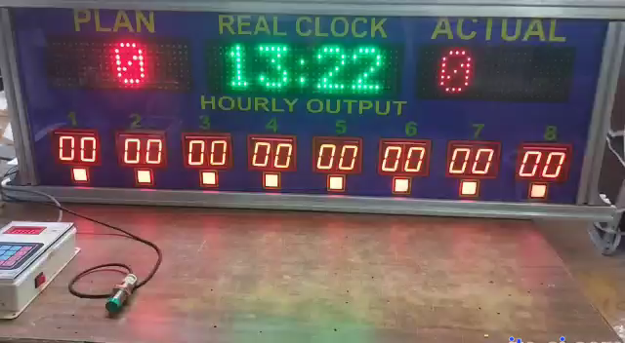
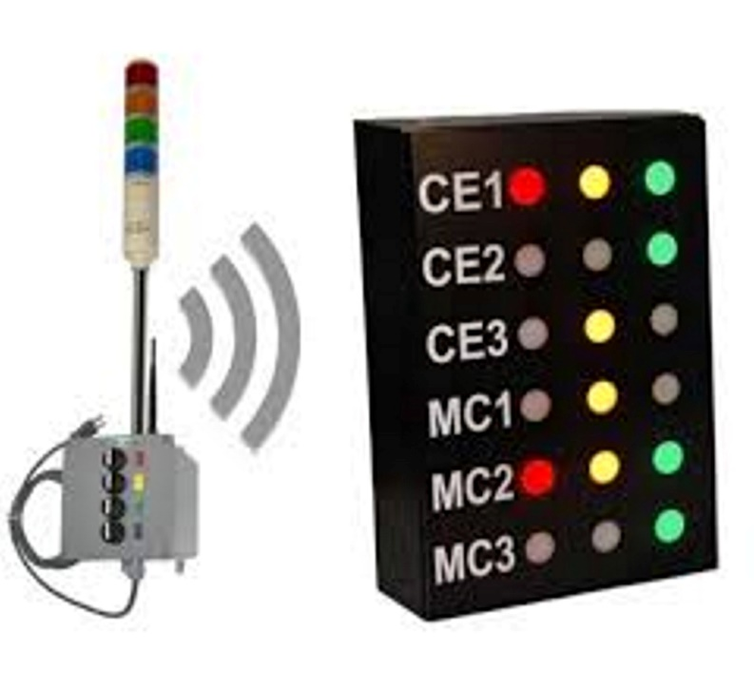
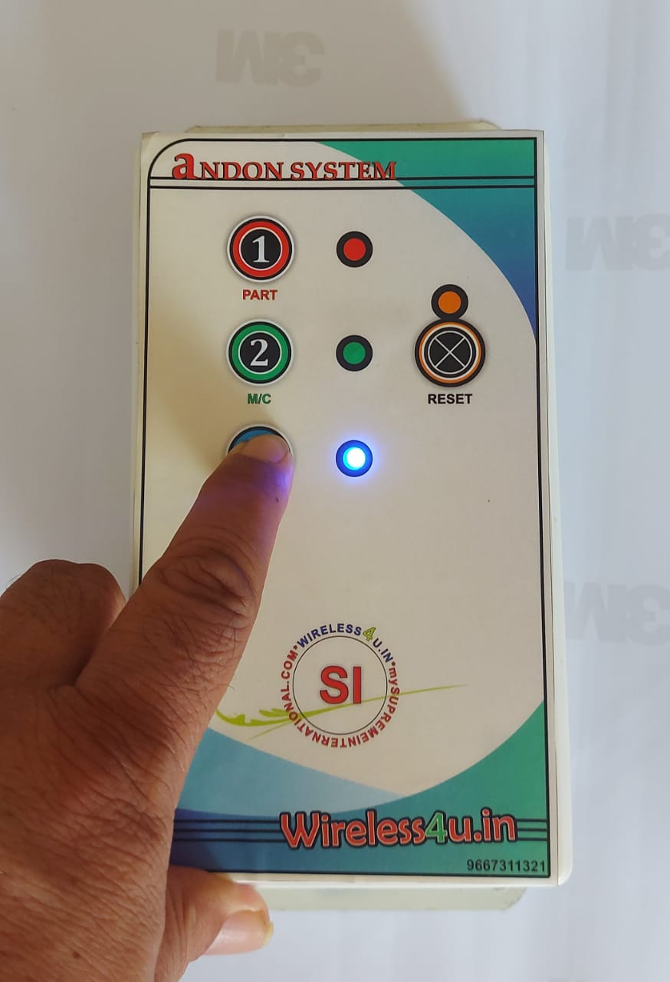
Reference Andon system
Move mouse here to play video
Video showing Andon system with Display Panel Example
Andon system with Hooter and Display
Andon system Remote unit

Slide 14
Thank You

